Slide 1
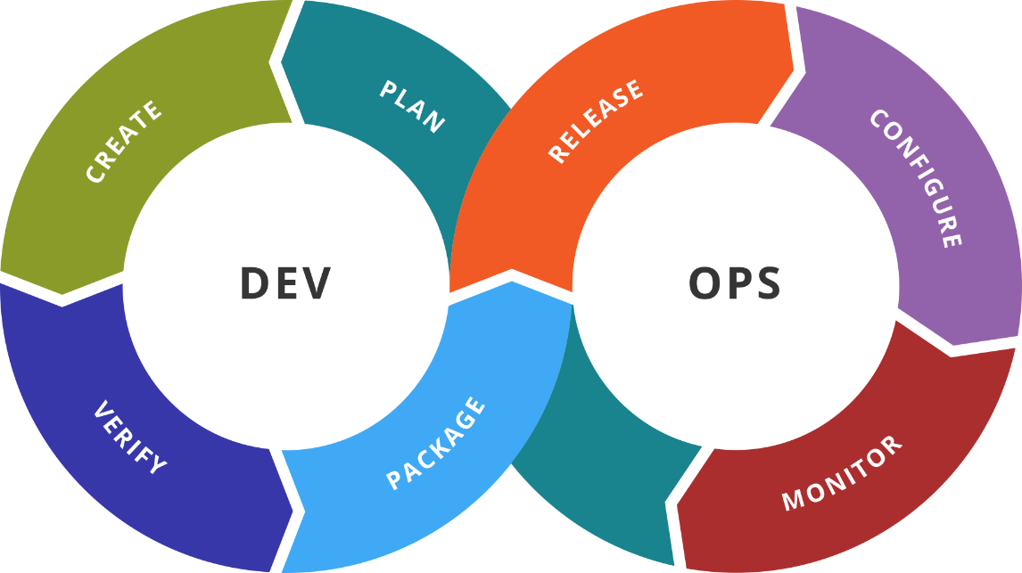
DevOps Containerization, CI/CD, and Monitoring
Course Introduction
SoftUni Team
Technical Trainers
Software University
https://softuni.bg

Slide 2
You Have Questions?
sli.do
#DevOps-23
facebook.com
/groups/DevOpsContainerizationCICDMonitoringJanuary2023

Slide 3














SoftUni Diamond Partners

Slide 4

Educational Partners

Slide 5
Table of Contents
Course objectives, scope, and schedule
Infrastructure
Exercises and labs
Examination
5

Slide 6

Course Scope and Objectives

Slide 7
Course Objectives
Working with Docker
Working with Jenkins
Working with Prometheus and Grafana
Working with Elastic Stack
Putting it all together

Slide 8
Course Scope and Schedule (1)
Week #1
DevOps basic principles
Processes and tools
Virtualization and basic automation with Vagrant
Week #2
Containerization basic principles
Introduction to Docker
Installation and configuration of Docker
Working with images and containers

Slide 9
Course Scope and Schedule (2)
Week #3
Additional techniques
Distributed applications
Docker clusters
Week #4
Introduction to Jenkins
Installation and configuration of Jenkins
Working with Jenkins

Slide 10
Course Scope and Schedule (3)
Week #5
Additional techniques with Jenkins
Distributed workload
Week #6
Introduction to Prometheus and Grafana
Installation and configuration of Prometheus and Grafana
Working with Prometheus and Grafana

Slide 11
Course Scope and Schedule (4)
Week #7
Introduction to Elastic Stack
Installation and configuration of Elastic Stack
Working with Elastic Stack
Week #8
Course Overview
Exam Preparation

Slide 12
Is This Enough?
The short answer is NO (or IT DEPENDS)
Learning by doing is the key
Experiment with different scenarios
Use various ways to manage the infrastructure
Read a book or two (or even more) on the subject
Attend other courses on the subject as well

Slide 13

Infrastructure
Requirements and Landscape

Slide 14
Required Infrastructure*
Processor that supports VT-x or AMD-V
At least 8 GB of free RAM. More is better
At least 80 GB of free disk space. More is better
Computer running a recent version of Windows, macOS or Linux
Virtualization software (VirtualBox, VMware …, Hyper-V)
Any cloud platform (offering IaaS) will do the job as well
Best option is an Intel compatible PC with VirtualBox installed

Slide 15
Required Knowledge
Basic knowledge about virtualization
Basic Linux administration skills
Basic networking skills
Basic scripting skills

Slide 16

More Details
Duration, Languages, Technologies

Slide 17

Why English?
Why are the slides in English?
English is the native language of the IT people
Specific terminology should be in English
Translations are inaccurate and funny
Just learn English!
No excuses

Slide 18

Training Duration
Lectures: ~ 12 hours
Practical exercises (in class): ~ 12 hours
Homework: ~ 12 hours
Schedule: January 2023 – March 2023
Every Monday between 18:30 and 22:00
Regular Exam: 26 March 2023
Retake Exam: 1 April 2023
18:30 – 19:30 Part 1
19:30 – 19:45 Break 1
19:45 – 20:45 Part 2
20:45 – 21:00 Break 2
21:00 – 22:00 Part 3

Slide 19

Course Evaluation
Exam and Evaluation Criteria

Slide 20






Scoring
TEST
40 pts.
TEAM
PLAY
HOMEWORK
PRACTICE
EXAM
60 pts.
BONUS
10 pts.
EVALUATION
CRITERIA

Slide 21
Practice
Create and configure the required infrastructure
Deploy and configure the necessary tools and components
Fulfill the requirements in the most automated way possible
Additional tasks as per the exam requirements
Prove the solution is working as per the requirements

Slide 22
Test
30
minutes
20
single-choice
questions
10
multi-choice
questions

Slide 23
Homework
Every week, there will be homework (almost)
You must submit the solution within 7 days
7 assignments worth 1,43 points each
10 bonus points in total

Slide 24
Practice is Important
Just watch the lecture, do not try to follow
Repeat practice at home, in your own peace
Extend the practice with additional tasks
Do your homework
If this is not enough, ask for more

Slide 25

About Me
Just a Few Words

Slide 26


Dimitar Zahariev
During office hours, work as BI/DI Consultant
Passionate about technology and teaching
Other side activities:
openSUSE Advocate
VMUG Bulgaria Leader
SoftUni
Forum
Facebook
Group
Sli.do

Slide 27



About You
Just a Short Form

Slide 28
About You
Go here:
https://zahariev.pro/go/do1-form
Write down a few words about you
Share your expectations/suggestions

Slide 29

Summary
We are ready to move forward.

Slide 30
Questions?
Notes:
30

Slide 31

License
This course (slides, examples, demos, exercises, homework, documents, videos and other assets) is copyrighted content
Unauthorized copy, reproduction or use is illegal
© SoftUni – https://softuni.org
© Software University – https://softuni.bg
Notes:
31

Slide 32
Trainings @ Software University (SoftUni)
Software University – High-Quality Education, Profession and Job for Software Developers
softuni.bg, softuni.org
Software University Foundation
softuni.foundation
Software University @ Facebook
facebook.com/SoftwareUniversity
Software University Forums
forum.softuni.bg
Notes:
32

